Slide 1


Team 48: Pocket Diagnostics
Bi-Weekly Update 3 Team Members: Rohan Bharadwaj, Donavan Burrow, Jacob Newlin, Elijah Rodriguez Sponsor: Dr. John Lusher TA:Zian Wang
Notes:
Michelle

Slide 2
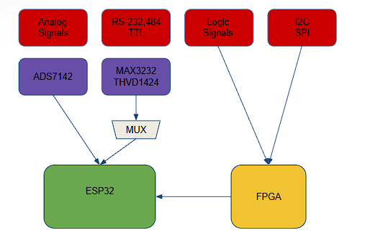
Project Summary
Problem statement:
Technicians in the electronics industry have evolved to servicing customers directly for consumer products, similarly to a plumber or electrician. Often they cannot bring or access bench devices and a suitable substitute is required to complete a job in a timely manner.
Function of the Pocket Diagnostics:
Provide a simple, man portable bench device that can evaluate low frequency electrical signals, I2C data signals, SPI data signals, Serial data signals and 16 channel logic signals for troubleshooting on devices that contain such data transfer methods.
Notes:
Kyle

Slide 3
Project/Subsystem Overview
Donavan
Elijah
Rohan
ADS7142
(OSCOPE)
FPGA
(Logic Signals)
UI
(Graphs/Inputs)
ESP32
(I2C/SPI)
COMM
(Read/Write)
POWER
(Battery/Charger)
MAX3232
THVD1424
(Serial port)
Notes:
Eric

Slide 4
Project Timeline
Subsystem Designs and Testing (to complete by 2/17 ) | Integration of Power and Data Processing subsystem with Data Acquisition and Communication Subsystem (to complete by 3/3) | Integration of App Development subsystem with Firmware subsystem. (to complete by 3/3) | Final Integration (to complete by 3/3) | System Test (to complete by 3/12) | Validation (to complete by 3/31) | Demo and Report (Prepared by 4/3)
Notes:
Eric

Slide 5
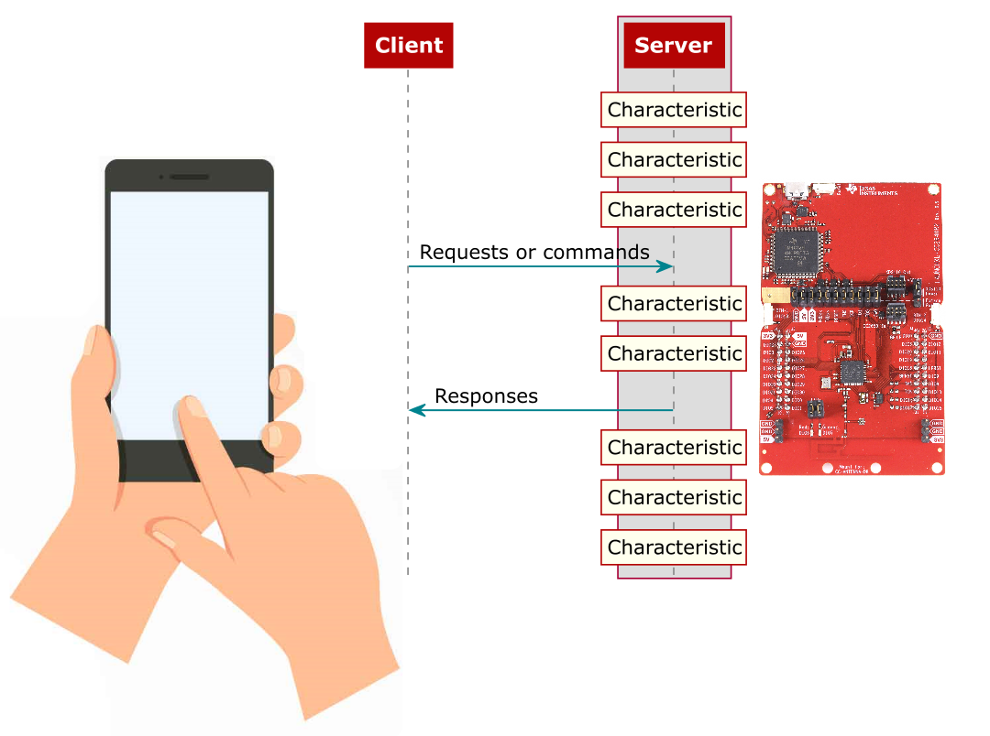
Firmware design
Jacob Newlin
Accomplishments since last update 14-16 hrs of effort | Ongoing progress/problems and plans until the next presentation
Finished 3 functions for FPGA covering I2C, SPI and Logic. Reworked and completed Oscilloscope and Serial data functions (ESP32). | Finish Top level function of FPGA, finish three functions associated with on the ESP32.

Slide 6
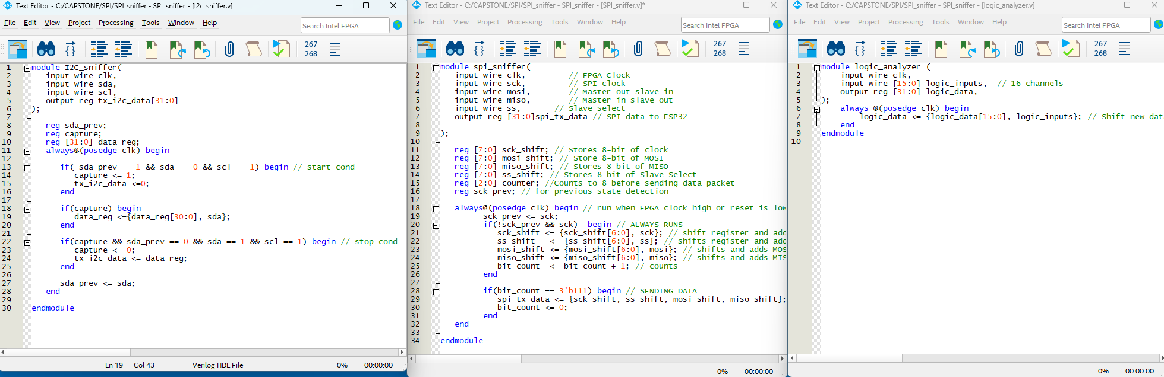
Firmware Design

Slide 7
Data Processing and Power
Rohan Bharadwaj
Accomplishments since last update 14 hrs of effort | Ongoing progress/problems and plans until the next presentation
Completed, ordered, and have begun assembling the integrated PCB. | Finish assembling PCB Integrate with Data Communication and Collection subsystem.

Slide 8
Data Communication and Collection
Elijah Rodriguez
Accomplishments since last update 20 hrs of effort | Ongoing progress/problems and plans until the next presentation
Updated Schematic and PCB with new competents and ordered the PCB PCB arrived yesterday so I began soldering, approximately 20% done with soldering process | Finish assembling and validating PCB Begin integration with data processing subsystem

Slide 9
App Design
Donavan Burrow
Accomplishments since last update 20 hrs of effort | Ongoing progress/problems and plans until the next presentation
Oscilloscope Integration Complete App UI completed | Oscilloscope Integration testing Integration of other data types

Slide 10
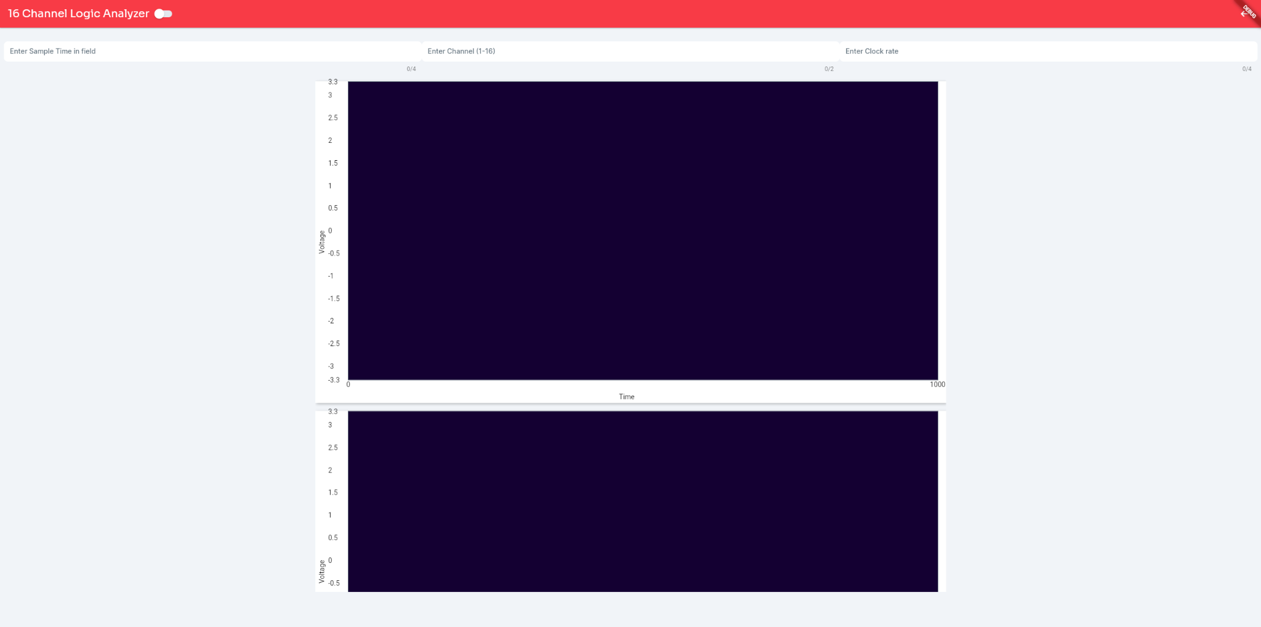
App Design
Donavan Burrow
App UI for Logic analyzer

Slide 11
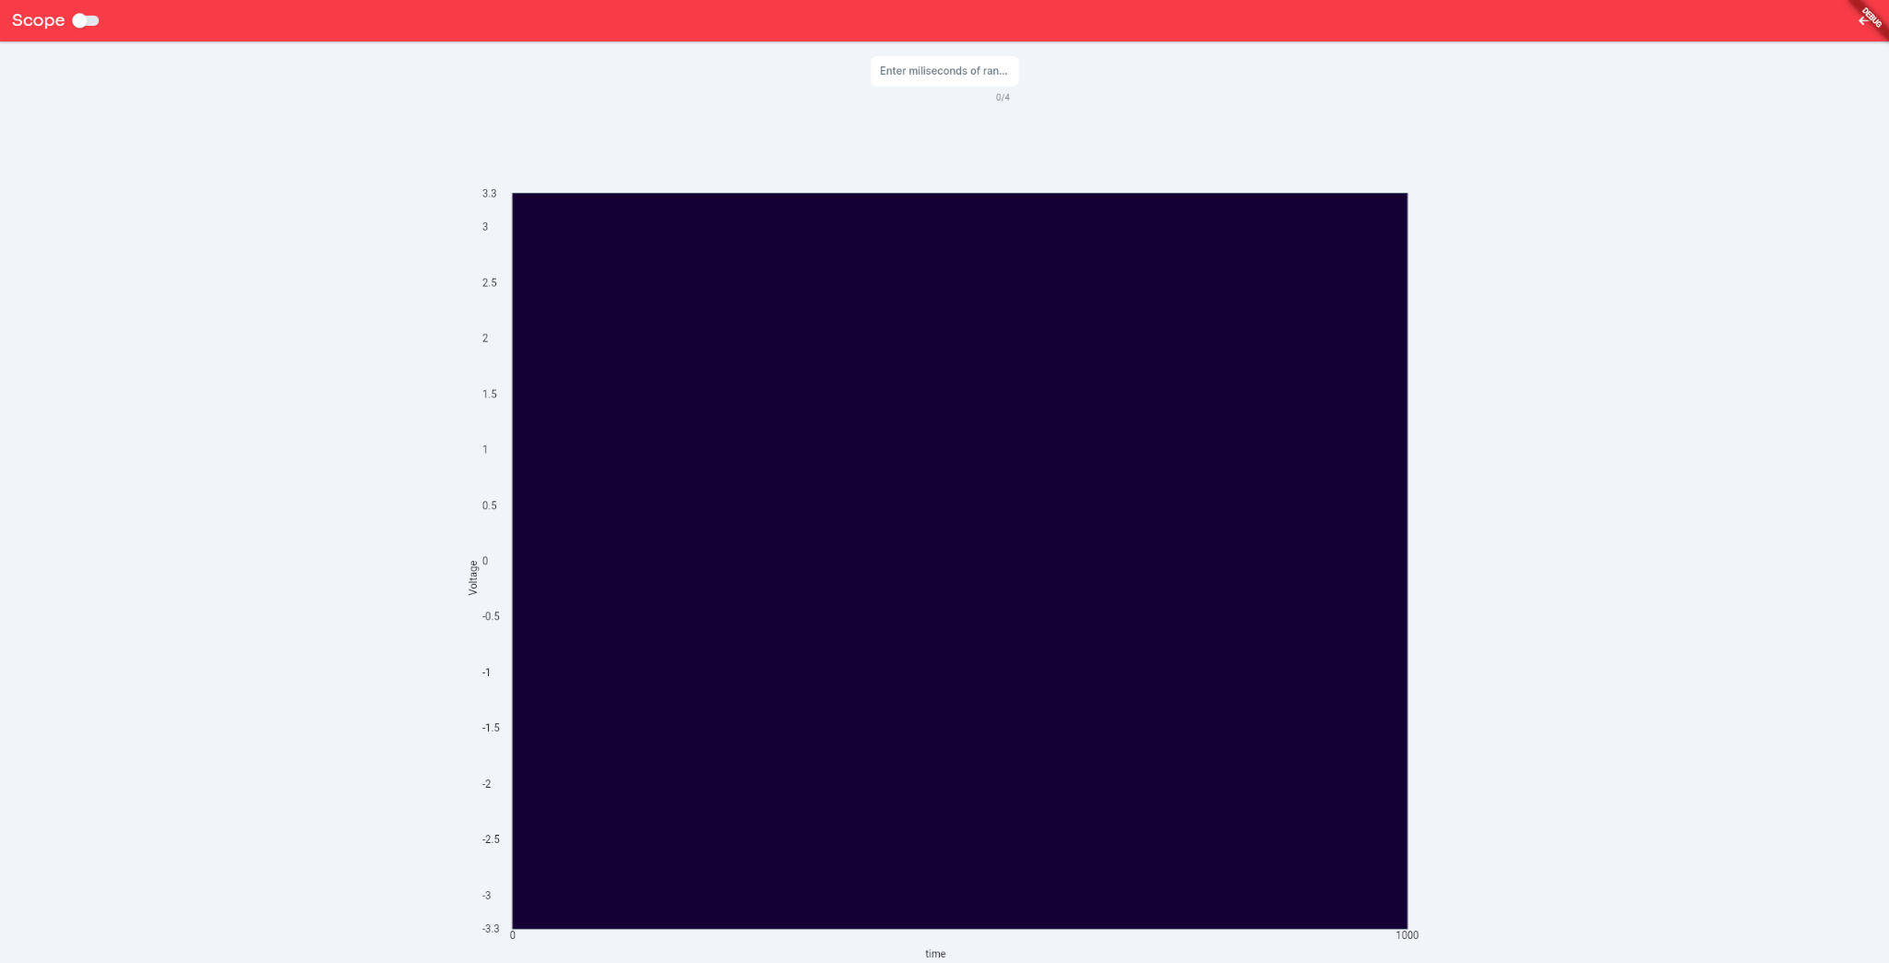
App Design
Donavan Burrow
App UI for Oscilloscope

Slide 12
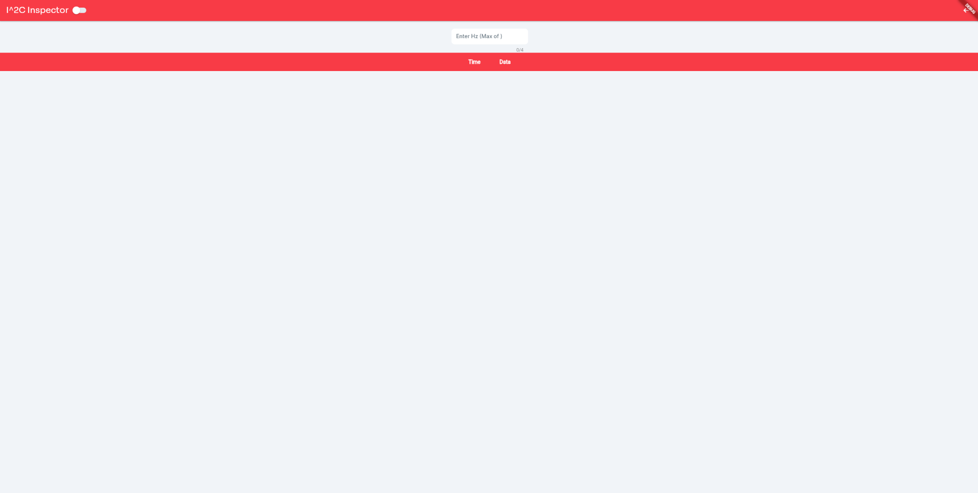
App Design
Donavan Burrow
App UI for serial data(SPI and I^2C)

Slide 13
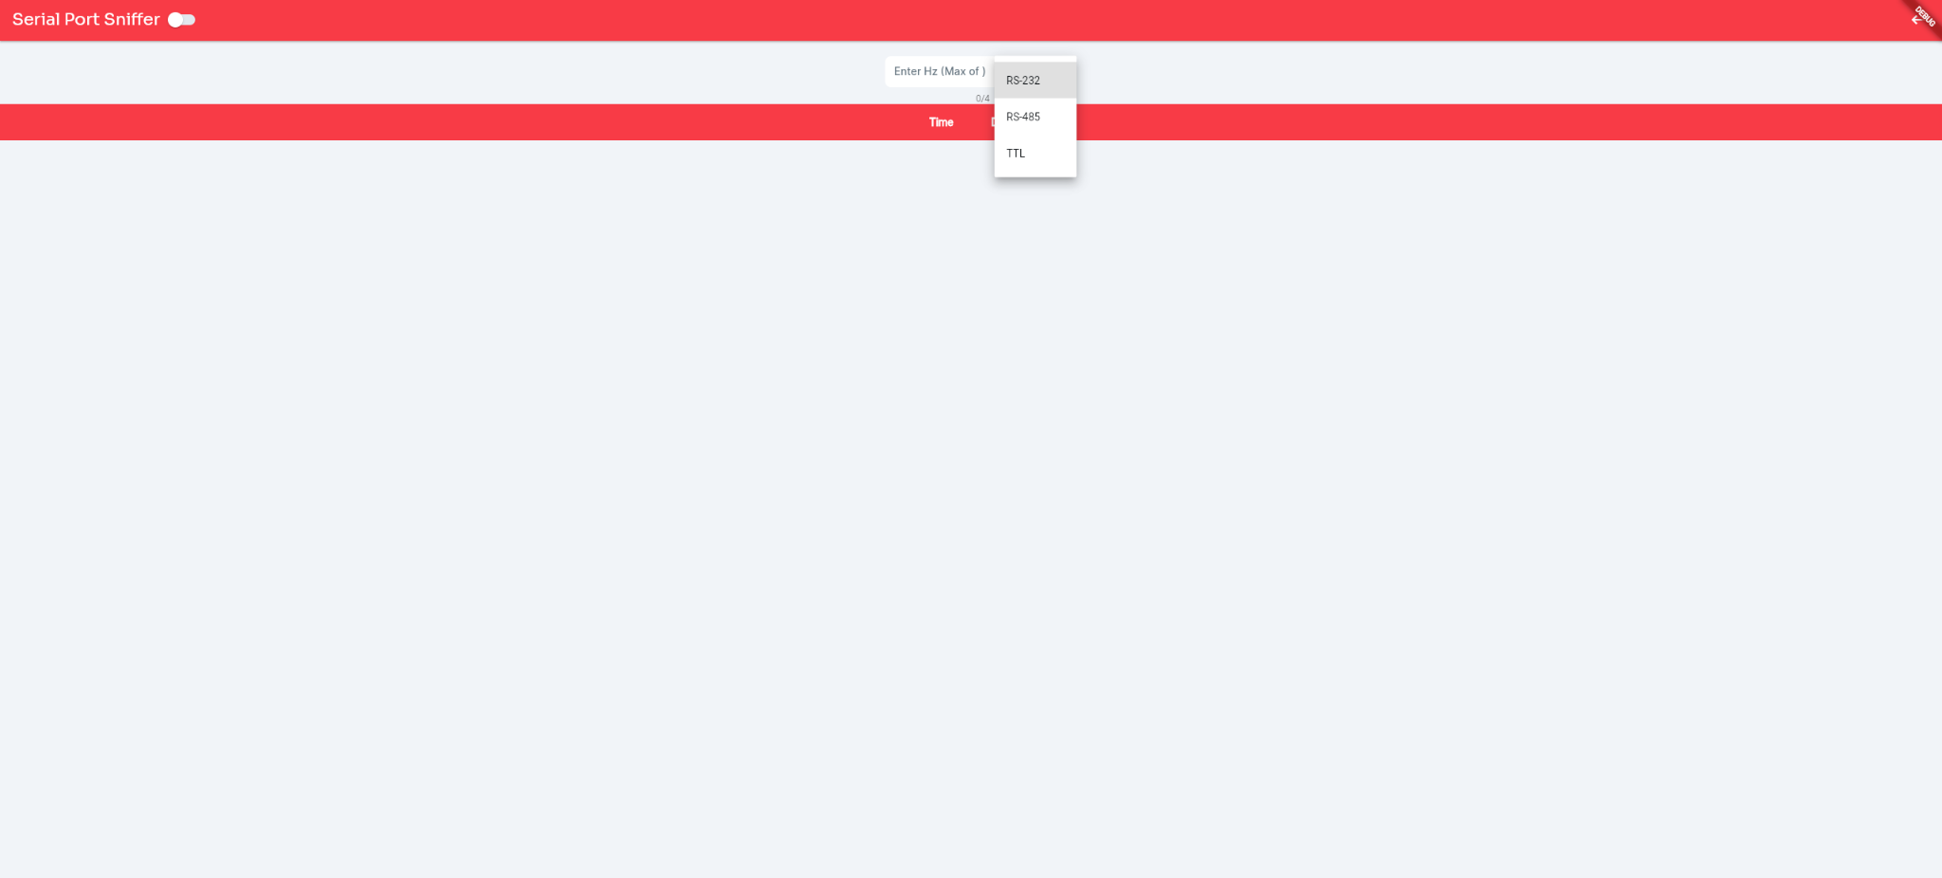
App Design
Donavan Burrow
App UI for serial data(RS232, 485 and TTL)

Slide 14
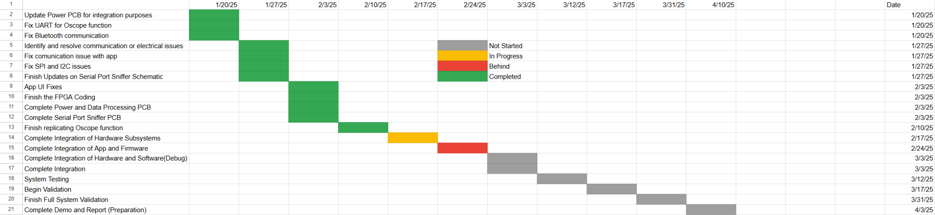
Execution Plan
Notes:
Michelle

Slide 15
Validation Plan
Paragraph # | Test Name | Success Criteria | Data | Status | Pass/Fail | Responsible Party
3.2.1.1 | Multi-Protocol Communication | Perform multi-protocol I. communication.1 MHz clock rate |  | UNTESTED |  | Rohan Bharadwaj, Elijah Rodriguez
3.2.1.2 | Data Acquisition for Low-Frequency Signals | Support data acquisition for low-frequency signals (up to 100 kHz) |  | UNTESTED |  | Rohan Bharadwaj, Elijah Rodriguez
3.2.1.3 | Logic Analysis | Capture and analyze signals with a sampling rate of up to 50 MS/s |  | UNTESTED |  | Rohan Bharadwaj
3.2.2.4 | Battery Life | 8 hours |  | UNTESTED |  | Rohan Bharadwaj
3.2.3.1.1 | Power Consumption | Maximum peak power should not exceed 4.5W |  | UNTESTED |  | Rohan Bharadwaj
3.2.3.1.2 | Input Voltage Level | 3.3-3.7V |  | UNTESTED |  | Rohan Bharadwaj
4.3.1.1 | Power Distribution Validation | MAX3232 and THVD1451 receive 3.3V from ESP32 |  | UNTESTED |  | Elijah Rodriguez
4.3.2.1 | MAX3232 and THVD1451 Level Shifting Verification | Voltage levels to 3.3V for the MAX3232 and THVD1451 |  | UNTESTED |  | Elijah Rodriguez
4.3.3.1 | RealTerm Communication Validation | Ensure transmitted and received data match the RealTerm program |  | UNTESTED |  | Elijah Rodriguez
4.3.4.1 | Signal Integrity Validation | Stable signal waveforms for RS protocols |  | UNTESTED |  | Elijah Rodriguez
Notes:
Michelle

Slide 16
Validation Plan
Paragraph # | Test Name | Success Criteria | Data | Status | Pass/Fail | Responsible Party
5.2.1 | Bluetooth Connection Event | Connection event displayed on app for phone and ESP32 | “Device Connected” displayed in terminal | TESTED | PASS | Donavan Burrow, Jacob Newlin
5.2.2 | Bluetooth Read | “Received Data” List with all data displayed | ‘Received Data: […]’ | TESTED | PASS | Donavan Burrow, Jacob Newlin
5.2.2 | Bluetooth Write | Terminal Displays all data transactions | ‘utf8(“Data type”), Time, Time’ | TESTED | PASS | Donavan Burrow, Jacob Newlin
5.2.3 | Data Display | Phone displays correct data on graph for each data type |  | UNTESTED |  | Donavan Burrow

Slide 17
Thank You!

